Slide 1


Creating Awesome Animations using ConstraintLayout & ConstraintSet
Hari Vignesh Jayapalan
@HariOfSpades

Slide 2


8721 days of employment generated
Winner of Facebook’s India Innovation Challenge

Slide 3
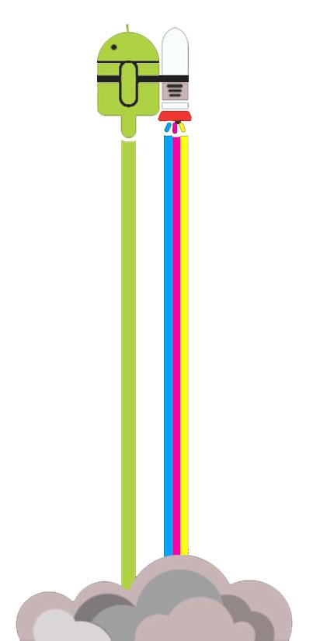
Pit Stops
ConstraintLayout Intro
Animation Examples
Basic Example
How it works?
FAQs
Other Examples
Transitions
Heads-up

Slide 4
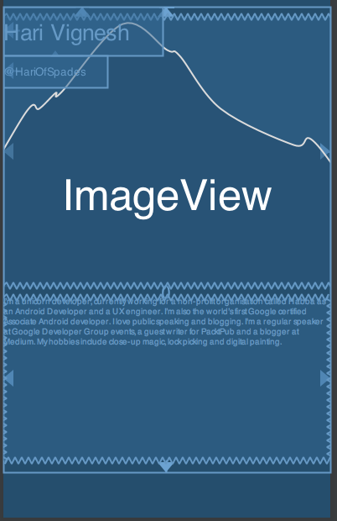
Intro: ConstraintLayout
A powerful RelativeLayout
Flat view hierarchy management
Flexible with Layout Editor
Responsive UI

Slide 5
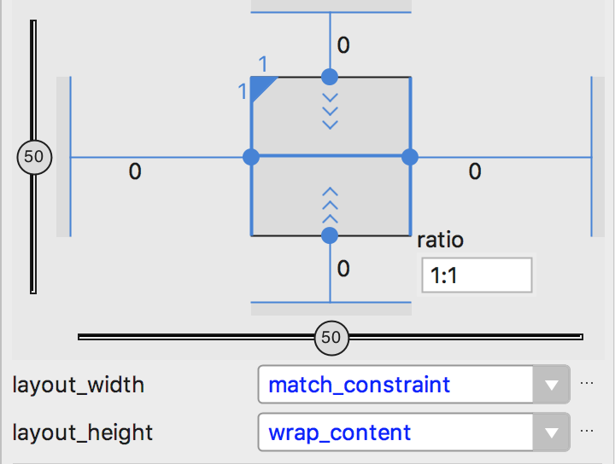
Working: ConstraintLayout
Constraints
Equations
Solver
Notes:
Position, dimension, guidelines, chains

Slide 6
Working: ConstraintLayout
Constraints
Equations
Solver
a1x1 + …. + a1xn = b
a1x1 + …. + a1xn <= b
a1x1 + …. + a1xn >= b

Slide 7
Working: ConstraintLayout
Constraints
Equations
Solver
Cassowary linear arithmetic constraint solving algorithm

Slide 8
Examples: Animation

Slide 9
Example: Basic
Click on the Android Mascot
Translate it to the bottom
Increase the size of the Mascot at the end
Click from bottom, viceversa

Slide 10
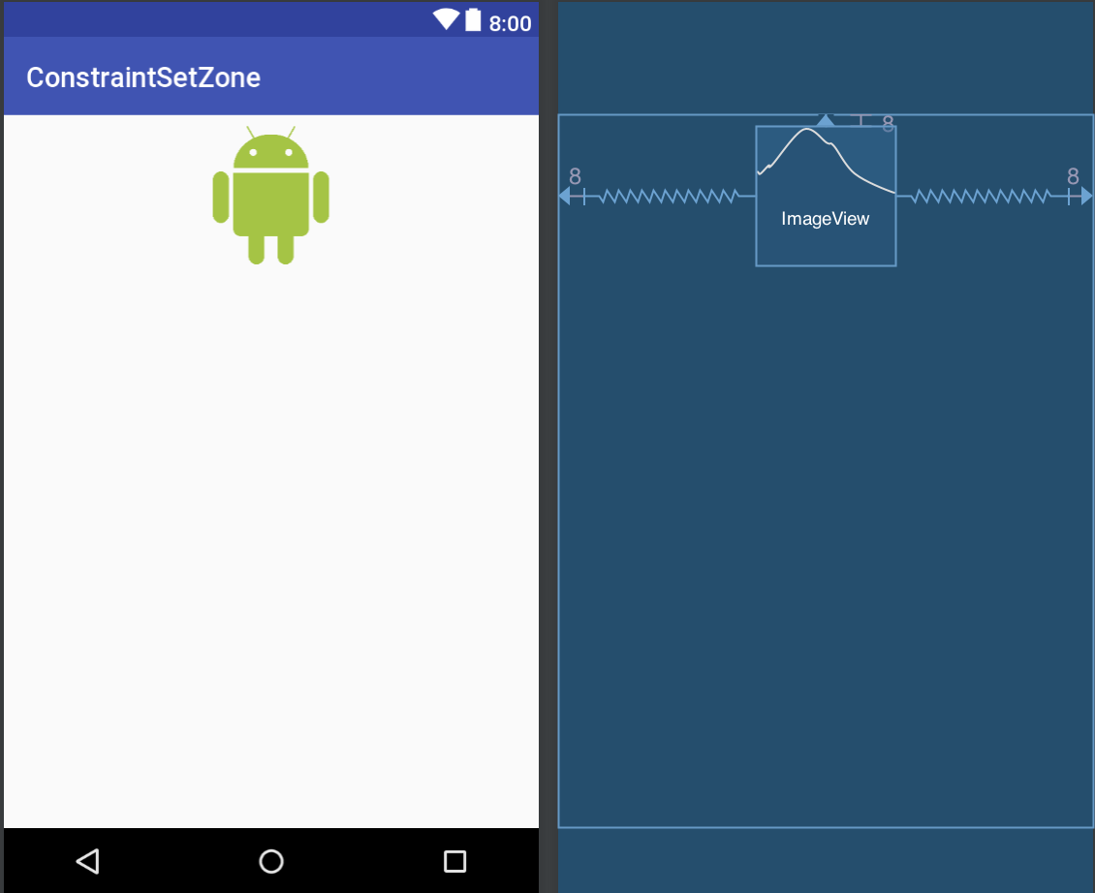
Step 1: First Layout
<android.support.constraint.ConstraintLayout ....android:id="@+id/root"> <ImageView android:id="@+id/imageView" android:layout_width="100dp" android:layout_height="100dp" android:layout_marginEnd="8dp" android:layout_marginStart="8dp" android:layout_marginTop="8dp" ... app:srcCompat="@drawable/android" /> </android.support.constraint.ConstraintLayout>

Slide 11
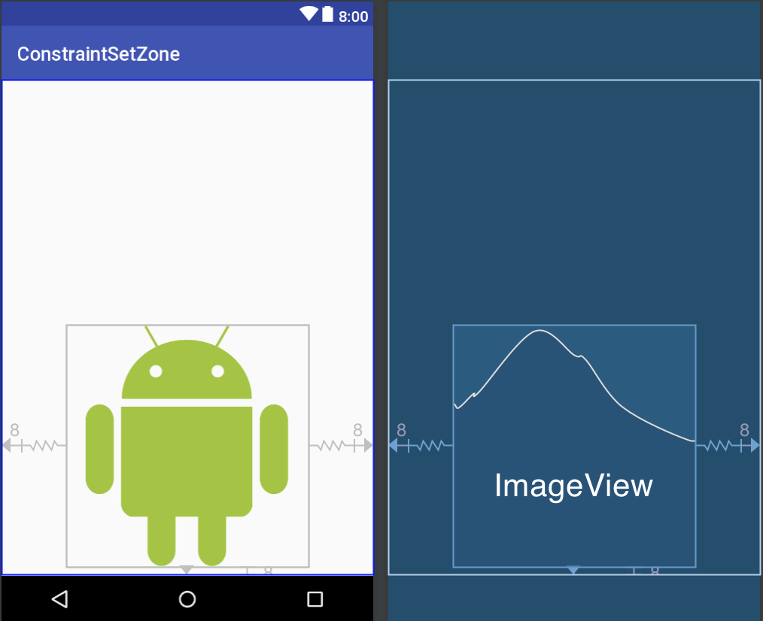
Step 2: Second Layout
<android.support.constraint.ConstraintLayout ...android:id="@+id/root"....> <ImageView android:id="@+id/imageView" android:layout_width="250dp" android:layout_height="250dp" android:layout_marginBottom="8dp" android:layout_marginEnd="8dp" android:layout_marginStart="8dp" .... app:srcCompat="@drawable/android" /> </android.support.constraint.ConstraintLayout>

Slide 12
Step 3: Transition
private fun createAnimation() { var set = false val constraintOne = ConstraintSet() constraintOne.clone(root) //CL id of 1st layout val constraintTwo = ConstraintSet() constraintTwo.load(this, R.layout.activity_image_alt) //2nd layout findViewById<ImageView>(R.id.imageView).setOnClickListener{ TransitionManager.beginDelayedTransition(root) val constraint = if(set) constraintOne else constraintTwo constraint.applyTo(root) set = !set } }
For Java : goo.gl/Aooymi

Slide 13
Step 4?
Run!

Slide 14
What ?: ConstraintSet
val constraintOne = ConstraintSet() /** class allows you to define programmatically a set of constraints to be used with ConstraintLayout **/

Slide 15
What ?: clone(), load()
constraintOne.clone(constraintLayoutID) /** method, will absorb all the constraint mappings and properties of a particular layout. **/ constraintTwo.load(this, R.layout.activity_image_alt) /** method, will absorb all the constraint mappings and properties of a particular layout. **/

Slide 16
What ?: TransitionManager
TransitionManager /** class manages the set of transitions that fire when there is a change of Scene **/ TransitionManager.beginDelayedTransition(constLayoutID) /** convenience method to animate, using the default transition **/

Slide 17
What ?: applyTo()
constraint.applyTo(constraintLayoutID) /** sets or applies the new or requested constraints to the view specified. **/

Slide 18
How ?: Working
We got the constraints from default layout using clone() and mapped it to constraintOne val constraintOne = ConstraintSet() constraintOne.clone(constraintLayoutID)
We got the constraints from the alternate layout using load() and mapped it to constraintTwo val constraintTwo = ConstraintSet() constraintTwo.load(this, R.layout.activity_image_alt)

Slide 19
How ?: Working
Then with the help of our TransitionManager, we initiated a default transition using beginDelayedTransition() to our root ConstraintLayout TransitionManager.beginDelayedTransition(constraintLayoutId)
Based on the set value, we changed and applied the Constraints using the method applyTo() constraint.applyTo(constraintLayoutID)

Slide 20
How ?: Working
private fun createAnimation() { var set = false val constraintOne = ConstraintSet() constraintOne.clone(root) //CL id of 1st layout val constraintTwo = ConstraintSet() constraintTwo.load(this, R.layout.activity_image_alt) findViewById<ImageView>(R.id.imageView).setOnClickListener{ TransitionManager.beginDelayedTransition(root) val constraint = if(set) constraintOne else constraintTwo constraint.applyTo(root) set = !set } }

Slide 21
FAQs
Duplicating a layout for an Animation, not a good thing right?
Same animation can be achieved using Object-Animator, physics based animation and other ways. Why this?
This method needs ConstraintLayout. How about animating the nested views or the child views?
GPU load?

Slide 22
Duplicating Layout?
If you want to animate only single view, instead of duplicating, you can do the following
TransitionManager.beginDelayedTransition(constraintLayoutID) textView.minHeight = 200

Slide 23
Why this animation?
When you have your layouts built using ConstraintLayout
Less code
Less time
Less math
When you want many views to be animated on a single event

Slide 24
In Nested Views?
Create primary layout with nesting
Create secondary layout without nesting
Perform the transition

Slide 25
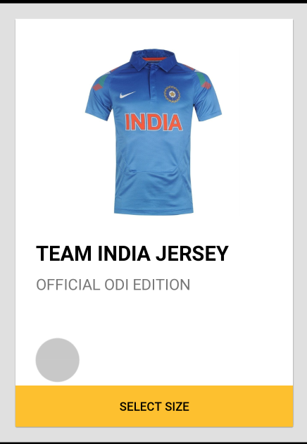
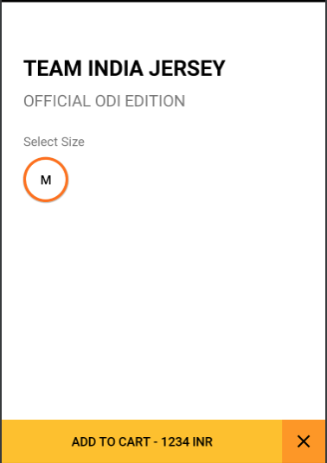
In Nested Views?

Slide 26
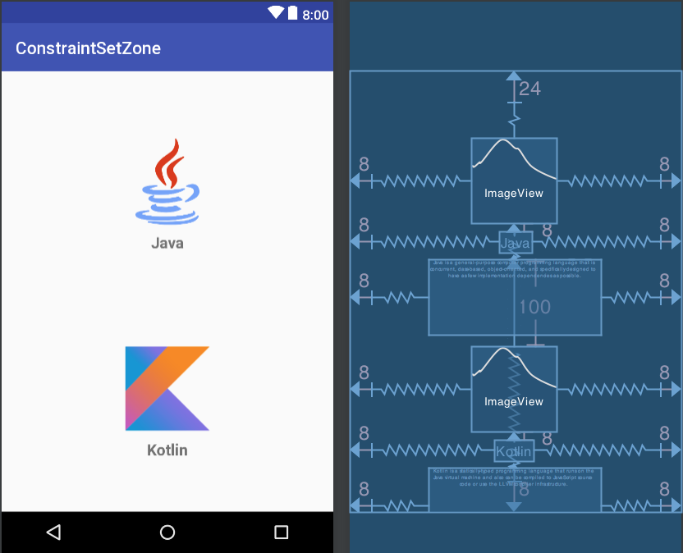
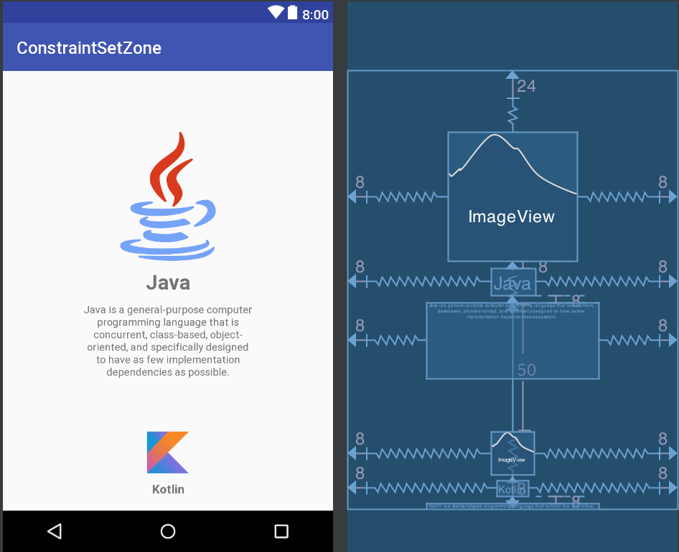
Java & Kotlin Example (1/2)

Slide 27
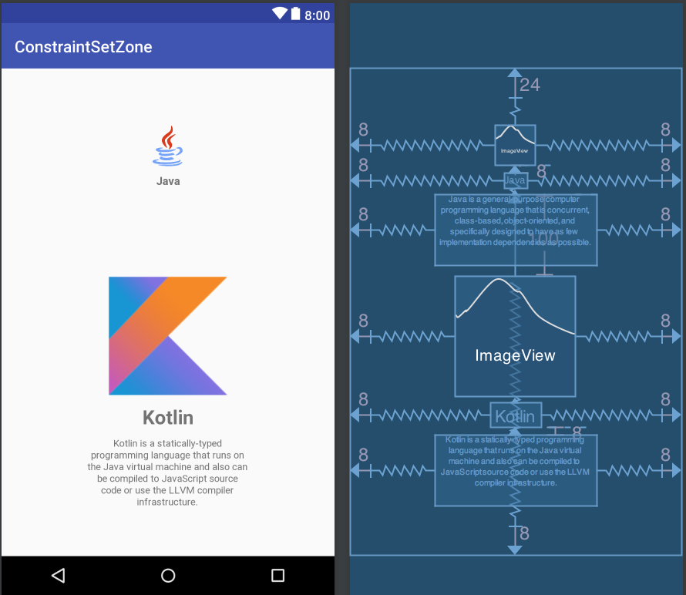
Java & Kotlin Example (2/2)

Slide 28
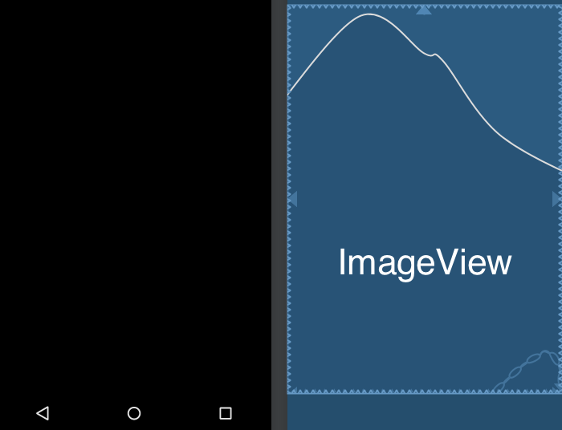


Profile Example (1/2)

Slide 29
Profile Example (2/2)

Slide 30
Other Transitions
BounceInterpolator
CycleInterpolator
DecelerateInterpolator
LinearInterpolator
OvershootInterpolator
PathInterpolator
val transition = ChangeBounds() transition.interpolator = OvershootInterpolator() TransitionManager.beginDelayedTransition(root, transition)

Slide 31
Heads Up
ConstraintLayout and ConstraintSet supports from API 9 onwards
TransitionManager is from API 14 onwards
Beware of nesting layouts
Beware of load() method

Slide 32
Recap

Slide 33
Other Resources
Github project - goo.gl/ibchbB
Medium post on ConstraintLayout Animation - goo.gl/i5Thzq
Video by Sean McQuillan - goo.gl/yrUdci
Robinhood Engineering post - goo.gl/f8RczZ

Slide 34
Thank you
Hari Vignesh Jayapalan
@HariOfSpades

